Slide 1
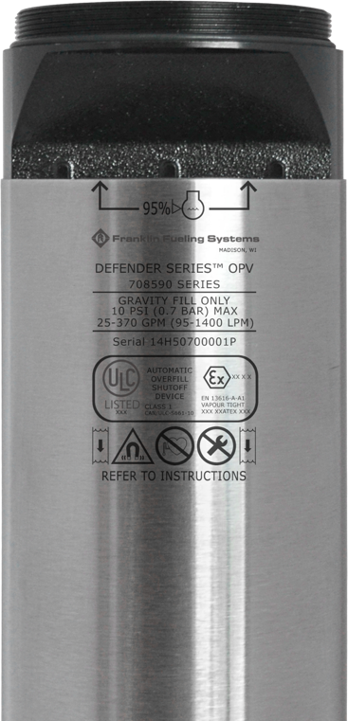

Slide 2
DEFENDER SERIES™ OVERFILL PREVENTION
Zero Leak paths
High and Low flow applications
Simple Installation
Remote Testing
AGB compatible
CARB approved

Slide 3
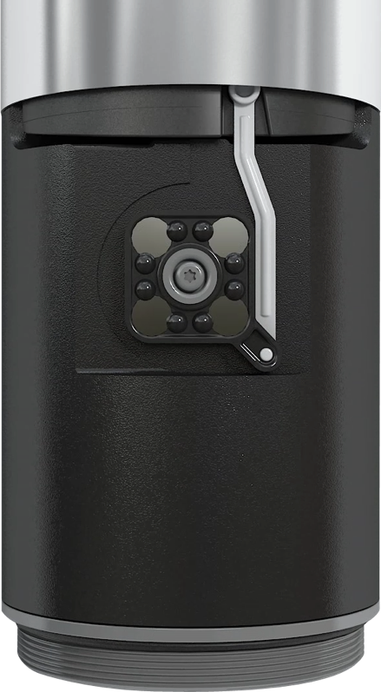
ZERO LEAK POINTS
Magnetic-coupled actuator system
Zero penetrations in valve body
Factory tested for 100% vapor tightness
.
CLOSED
ZERO VAPOR PATHS
The absence of body penetrations in the OPV eliminates potential leak paths for escaping vapors.
FACTORY TESTED
Every unit is factory tested for 100% vapor tightness to ensure a clean, fugitive emission-free forecourt.
COMPLIANCE READY
With increasing vapor recovery regulations around the world, the Defender Series™ OPV will have you ready for compliance.
Notes:
The Defender SeriesTM Overfill Prevention Valve or OPV utilizes a new and revolutionary design. It utilizes a magnetic coupler to transfer the external float motion to the internal valves. Why is this important? It means that there are zero penetrations through the body. With no penetrations the valve itself cannot leak. Mention new riveted shell.

Slide 4
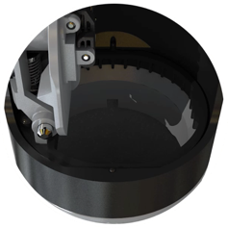
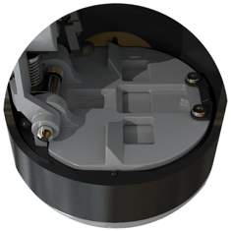
HIGH OR LOW FLOW
Minimal flow path obstructions accommodate high flow drops
Magnetically-coupled actuator system provides reliable positive shutoff for low flow drops.
OPEN
CLOSED
ALL FLOW RATES
The Defender Series™ OPV accommodates a broad range of flow rates from 25 gpm to 370 gpm(95 lpm to 1,400 lpm).
HIGH FLOW OPERATION
In high flow applications, the actuator system will hold the flapper in place, only releasing it into the flow of fuel once the float has risen to generate positive shutoff.
LOW FLOW OPERATION
In low flow applications, the actuator system will assist by kicking the flapper out into the flow of fuel to generate positive shutoff.
Notes:
FFS’s model 708-590 Series Overfill Prevention Valve should only be installed in a spill container through a 4" (102 mm) schedule 40 tank riser. The valve is designed with a primary shutoff that will activate between 85 and 92% of tank volume, depending upon tank size. After the primary shut-off is actuated the flow through the valve is limited to less than 8 gpm (30 lpm). A secondary, positive shutoff will occur at 95% tank volume if filling continues. After primary shutoff occurs, the delivery hose may still be drained by using extreme caution, and taking these steps:
Close the truck bottom loading valve. Wait 5 minutes
Crack open the coupler between the delivery hose and the bottom loading valve, to allow the hose to drain slowly.
Note: Shutoff points are influenced by the specific gravity of stored liquids. These instructions are based on average performance using all products. This valve was designed to be used as an emergency overfill prevention device only!

Slide 5
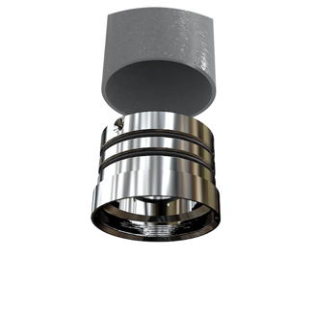
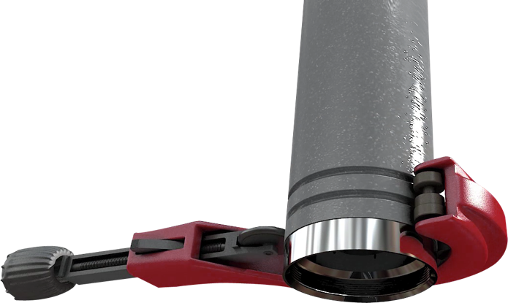
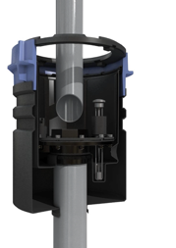
SIMPLE INSTALLATION
No flaring, riveting or epoxying drop tubes on site.
Thread on upper adapter
Dual roll-crimp grooves
Compatible with coaxial….
TOP ADAPTER
A special, double O-ring top adapter is used to attach the drop tube for easy installation without any drilling, riveting, epoxy or flaring tools.
IN-LINE ASSEMBLY
A perfectly in-line assembly installs smoothly into the riser and can be easily removed for maintenance.
EASY REPLACEMENT
With threaded top and bottom drop tube installation, damaged drop tubes can easily be replaced without having to purchase an entirely new assembly.
Notes:
The new design of the Defender SeriesTM OPV extends to the upper drop tube attachment method. The Defender OPV uses a thread-on upper adapter. This adapter allows any manufacturer’s upper drop tube to be used with the Defender SeriesTM OPV. The adapter has two grooves that are used in conjunction with a roll groove tool to create an air tight connection between the adapter and the upper drop tube. You will no longer need to use the flare tool for air tight installations.
When it comes to maintenance, the Defender Series OPV does not have a requirement for any periodic maintenance.

Slide 6
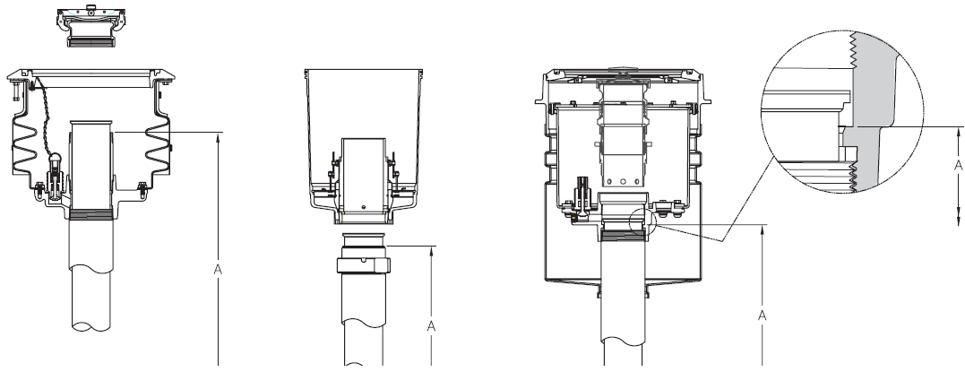
Installation Options
The Defender Series™ OPV can be installed in three different arrangements:
Beneath fill adapter
Beneath spill container
Inside spill container
Notes:
Shown here are three different scenarios of how the Defender Series OPV can be installed. The image on the left show how the OPV can be installed directly below the fill adapter. The middle image shows how the drop tube can be mounted below the spill container. Lastly, the OPV can be installed within the spill container base, as shown in the image on the right.

Slide 7
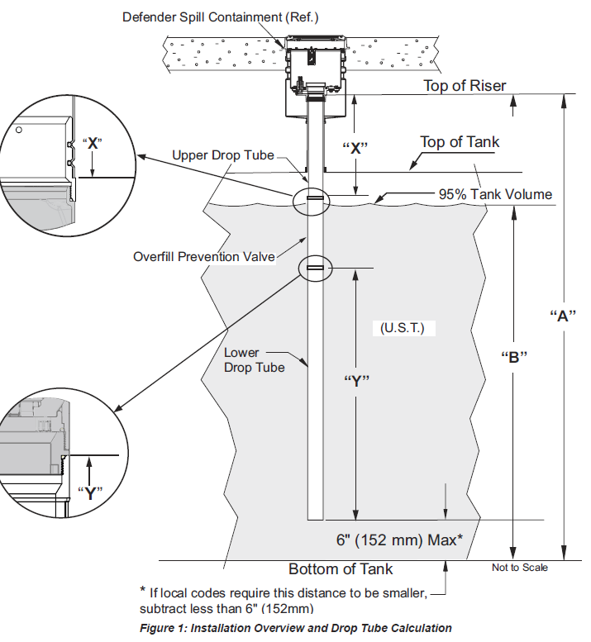
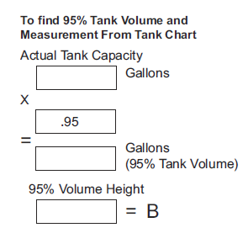
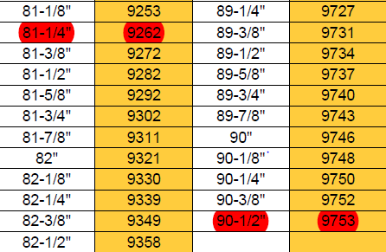
Calculating 95% Level for Installation
Measure “A”
Calculate “B”
Notes:
Critical to use the tank calibration chart to determine the tank volume.
The length of the upper drop tube, shown as dimension X, for the Defender SeriesTM OPV must first be determined. Franklin Fueling Systems suggests using the drop tube calculation worksheet found in the Defender SeriesTM OPV Installation, Operation, and Maintenance manual. The worksheet shows the following dimensions:
Dimension A:
This is the distance from the seat surface of the upper drop tube to the inside of the top of the tank. The seat surface installation dimension will vary depending on the spill container used. For manway applications, be sure to include the height of the manway to the inside of the top of the tank
Dimension B:
This is the 95% tank volume offset and is obtained from the tank chart provided by the tank manufacturer. This is typically equal to the 5% level measurement. To find the 5% tank level on the tank chart, multiply the full tank capacity by .05. Then find on the tank chart the level measurement that matches the calculated volume the closest. For manway applications, be sure to include the height of the manway to the inside of the top of the tank. If tank tilt is an issue, the installing contractor may use best judgment to adjust the “B” dimension accordingly to avoid exposure of the fittings located on top of the tank to product due to overfilling
Dimension C:
This is the distance from the seat surface of the upper drop tube to the bottom of the tank
In example: 9753 gallons X .95 = 9265, B = 81 ¼” for the tank shown.

Slide 8
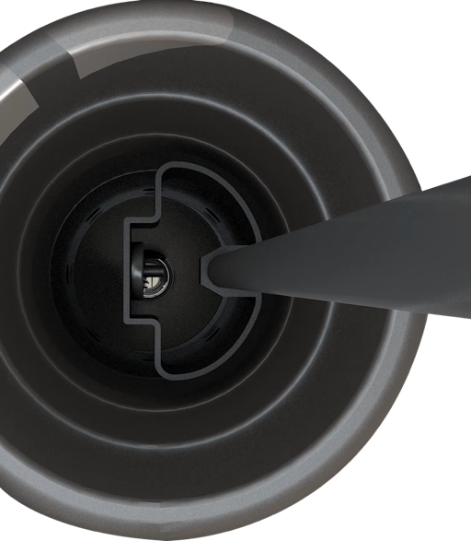
REMOTE TESTING
Perform primary functionality testing without valve removal
Testing tool actuates flapper via magnetically-coupled system
VISUAL TESTING
The remote testing tool will actuate the flapper when inserted down the drop tube and slid by the actuator - this is confirmed visually through a window in the tool.
CUSTOM TESTING TOOL
To accommodate varying tank sizes, the testing tool handle is segmented into six sections for customization up to 11 feet (3.35 meters) in length.
FAST INSPECTION
Fast visual inspection can be conducted by a single person in minutes without having to remove the complete drop tube and OPV assembly.
Notes:
An additional feature of the new Defender SeriesTM OPV is that it is remote testable using the testing tool. This means that the valve no longer has to be removed from the tank in order to verify operation.

Slide 9
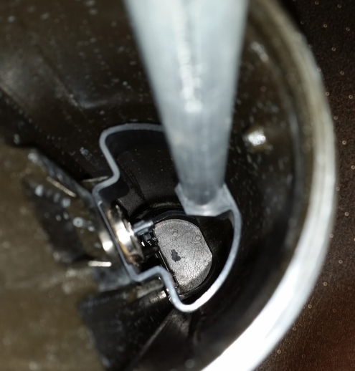
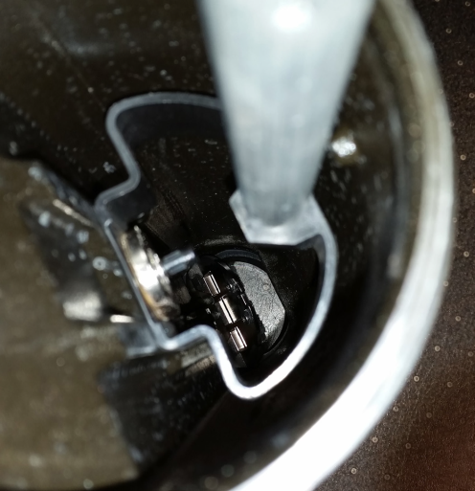
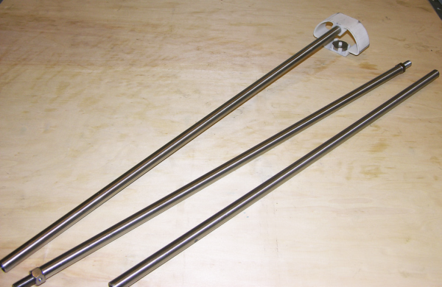
Operational Testing Procedure
Flapper in
Flapper out
Assemble remote test tool with enough extensions to reach OPV
Insert remote test tool. You should feel a “pull” when the magnets are positioned correctly
Raise the tool 1 ½” (38mm) and you should see the flapper move into the flow path
Notes:
Due to the design of the Defender Series Overfill Prevention Valve, operational testing is very easy.
First, assemble the remote test tool with enough extension sections to reach the Overfill Prevention Valve. Insert the remote test tool into the drop tube. You should feel a “pull” when the magnets are positioned correctly and attract. Slowly raise the remote test tool about 1 ½" (38mm) and you should see the flapper move into the flow path.
If flapper is seen moving back and forth, the OPV is functioning normally If required by local agency, a non-sparking stick/rod no larger than Ø.750” (19 mm) may be inserted through the remote test tool opening to push flapper to the fully closed position. To remove the remote test tool, simply pull out of the drop tube. The magnets will disengage and the flapper should reset automatically

Slide 10
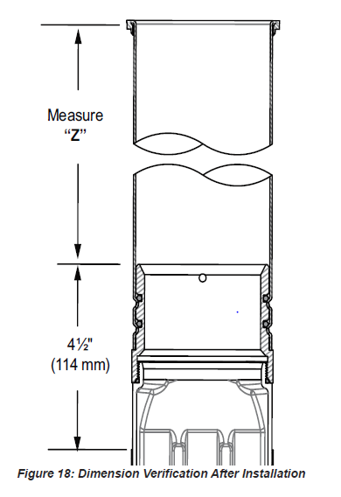
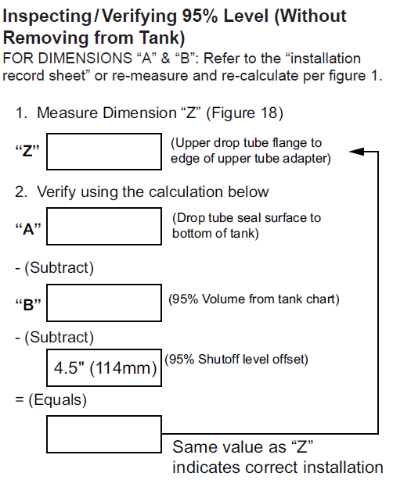
Verifying 95% Level without Removal
Notes:
There may come time when you need to verify that the Defender Series OPV is properly installed at the 95% level while its still installed within the tank. This is a very simple calculation. First, measure the distance from the top of the drop tube flange to the upper edge of the drop tube adapter. This will be known as Dimension “Z”.
Next, measure the distance from the drop tube seal surface to the bottom of the tank. This will be known as Dimension “A”. You may already have recorded this information on the “Installation Record Sheet”. Now, refer to the tank chart and record the 95% volume from it. This will be known as Dimension “B”.
Once you have these values, you take Dimension “A” and subtract Dimension “B” and then subtract 4.5” or 114mm. The 4.5” or 114mm represents the 95% shutoff level offset. If this value equals your original measurement of Dimension “Z”, then this indicates that the valve is correctly installed.
The form shown here is located within the installation, operation, and maintenance manual.

Slide 11
Defender Series™ OPV
Innovative magnetically-coupled actuator provides positive shutoff with zero leak points.
Simplified installation eliminates flaring, drilling, riveting, and epoxy for fast installation.
Reliable shutoff for both high flow or low flow fuel drops from 25 to 370 gpm (95 to 1,400 lpm).
Primary functionality testing capability without having to remove the assembly from the riser.
For use in all markets, fuel types and applications with simplified model offering.
WANT MORE?
Visit franklinfueling.com/OPV for more product information and literature downloads.

